Slide 1

ENME605 Teaching Experience- Feedback Linearization
Alex Beyer

Slide 2
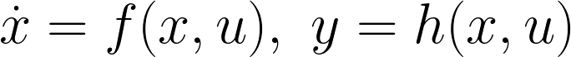
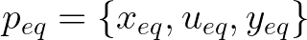
Linearization – The Jacobian
Given some nonlinear system:
We can build a linear approximation via:
Notes:
Before I explain how to use feedback linearization, I want to motivate the topic somewhat
As control engineers we want to work with linear systems; they have lots of really nice characteristics that makes modelling and control approachable and easy – a nonlinear system has almost none of these properties. To that end, engineers and mathematicians have come up with sets of tools to build well behaved linear approximations of nonlinear systems to make modeling and control more tractable. One of the most commonly used of these tools is the Jacobian, which we can use to build a “good-enough” local approximation of a linear system that we can investigate behavior around a desired point, like an equilibrium.
Above I’ve shown how to use the Jacobian to linearize a system, which is one of the most common approaches.
Once we’ve linearized our system we can begin to apply much more well understood methods of linear system control to it to achieve our desired performance.

Slide 3
Linearization
Linearizing a system gives it some nice properties that a nonlinear system doesn’t have:
Small changes in inputs map to small changes in outputs
Inputs obey additivity and homogeneity
Linearizing by the Jacobian creates an approximate system which does have these properties – but only locally
What if we could develop a more robust method to linearize systems?
Notes:
Some of the properties our newly linearized system has are:
-Small changes to the input will map to small changes in the output, useful for dealing with small disturbances
-Superposition
However, these linearizations only hold locally – the further we move from the point we linearized about, the larger the error grows. We can vary our approach a bit to mitigate this issue, but ultimately we can never escape it with this method. In this talk I’ll explore the basic ideas of feedback linearization, a technique which allows us to not only develop much more robust linear representations of systems, but extends fairly naturally to global linearization's of systems owing to the way in which it’s constructed.

Slide 4
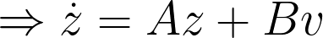
Feedback Linearization
Feedback Linearization gives us a set of tools to define a coordinate transform such that:
Where z is a set of coordinates in which our system is linear
However, before we can begin to define this coordinate transform there are a few tools we’ll need…
Notes:
Our goal with feedback linearization is to come up with a specifically built coordinate transform capable of moving a nonlinear system into a set of coordinates in which it behaves like a linear one. We make our first assumption here, namely that the control law for the nonlinear system comes in two parts: a pure state feedback control (ax) and designed controller (bv)
I’ll be focusing on the local SISO definition here for the sake of clarity; every argument I make here will extend to the global MIMO case naturally via the addition of extra control inputs (turning the g(x)u term into a sum across all control inputs), with global applicability hinging on the global truth of a few conditions presented in the next few slides.
BUT, before I can define the transform itself, I’ll need to set up a couple tools…

Slide 5
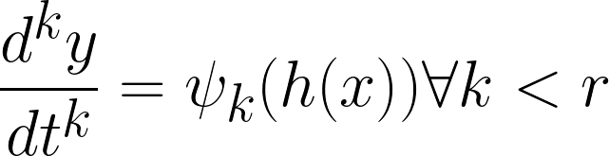
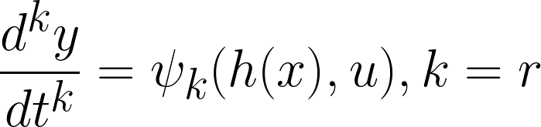
Relative System Degree (SISO)
For the nonlinear SISO system:
We define the relative degree r as the order of the first derivative of the output with respect to time in which the control input u appears:
Notes:
The first tool we need is called Relative System Degree. We can find the relative degree of our system by repeatedly differentiating the output with respect to time until a nonzero term containing the output appears, the order of that derivative is the systems degree
Notice that I haven’t defined what ψ is – that’s because there’s a problem with this definition. I’ve defined our output function to be h(x), where the time evolution of x is a function of our current state and input, with the input being a function of state – how do we find the time derivative of a system like this?

Slide 6
Lie Derivatives
Vector Field – The assignment of a vector to every point in a subset of space
Our Control System is a Vector Field!
We want to know how our output h(x) will vary w/r.t. the state x – how do we differentiate a vector field with respect to a vector?
Use the Lie Derivative!
Notes:
Luckily, that’s where the second necessary tool comes in! The Lie Derivative is the theoretical tool which holds this approach together, first we’ll use it to differentiate our output and eventually we’ll use it to construct our control law.
To be precise, our control system is a mathematical construction called a Vector Field, which takes in a vector corresponding to an n dimensional point (the state and input) and assigns it to another vector (in this case the output y or time rate of change of state x dot). Our end goal is to differentiate our output with respect to the state(s) so we’ll need to build a rigorous definition for what that means. Once we do this, all that’s left is algebra.

Slide 7
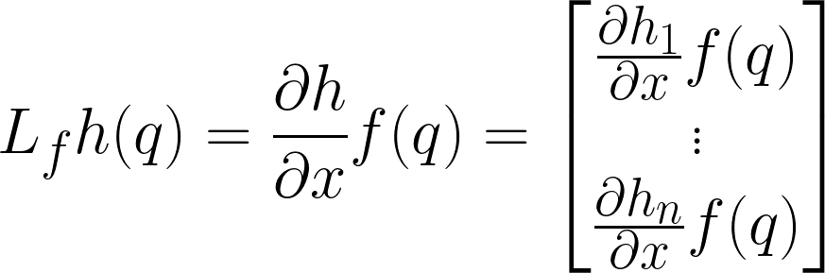
Lie Derivatives
The Lie Derivative, written generally as:
Generalizes the derivative, allowing us to speak about the rate of change of our output as we vary our state
Notes:
Similar to the jacobian, the Lie Derivative gives us the tools to evaluate the rate of change of a multiple valued function with respect to multiple inputs – in it’s simplest case it looks suspiciously like a Jacobian in fact.
I’m opting to forgo the full definition of a Lie Derivative which uses Lie Algebras (hence the name) to avoid delving too deeply into the abstract algebra – I’ll have a source for this linker at the end. In this case the Lie Derivative will look a lot like the jacobian because I’ve limited myself to the special case of vector and scalar values functions. These tools prove useful in many cases because, unlike the Jacobian, they are coordinate invariant.

Slide 8
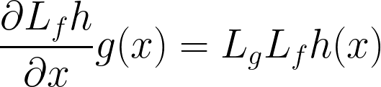
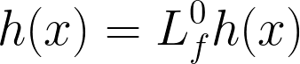
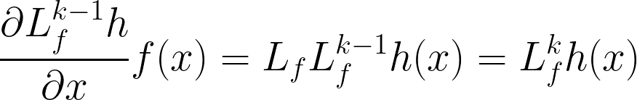
Lie Derivatives
Let’s define a few more properties of the Lie Derivative:
Notes:
We can extend our Lie Derivative notation a little bit to enable us to say things like:
-We can take mixed base Lie Derivatives by repeatedly differentiating and multiplying by different functions
-The 0th degree Lie Derivative of a function is just the function
-Lie Derivatives w/r.t. the same base will add their orders together when multiplied

Slide 9
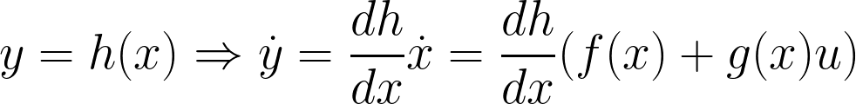
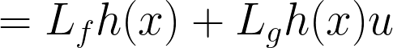
Relative System Degree – Lie Derivatives
How can we use the Lie Derivative to find Relative System Degree?
Let’s consider the time rate of change of our output:
Notes:
With that, let’s return to the idea of Relative System Degree and see how to define it using Lie Derivatives
First, we take the time derivative of our output, applying the chainrule as before to get yDot = (dh/dx)xDot, where we then substitute in our known expression for xDot
All of a sudden our control input u has appeared, it looks like we’ve found that system order will always be one! However, working this out and solving numerically reveals that for many systems the term Lgh(x)u is zero for all state inputs; u hasn’t necessarily appeared here and we will likely need to take more derivatives

Slide 10
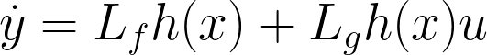
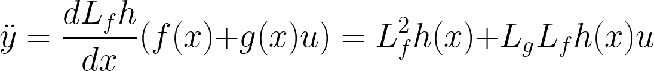
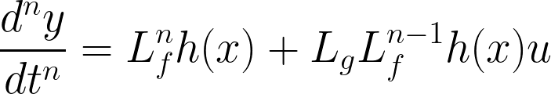
Relative System Degree – Repeated Lie Derivatives
The smallest n for which this is nonzero is the System Degree
Notes:
Repeated differentiations of our output make use of the rules we defined a few slides back; we see mixed base Lie Derivatives and higher order derivates appearing in the math! Each of these derivatives will follow the same structure, laid out on the bottom of this slide. Our system degree is that the smallest order n for which the second term (which contains the input u) is nonzero. Luckily, many common systems are of degree 2, making the LgLf matrix a square matrix very similar in construction to the Hessian

Slide 11
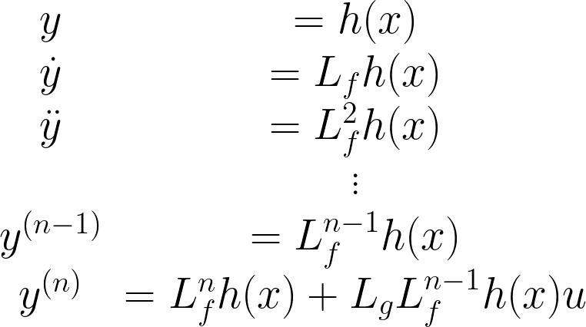
Feedback Linearization – Building the Transform
All this work setting up preliminaries means we can finally start to define our coordinate transform:
First, recognize that:
Notes:
Ultimately we want to find a coordinate transform that makes our system behave linearly while still taking the same control input u – luckily for us we’ve spent the past few slides building a particularly convenient set of coordinates which not only give us a fairly convenient set of coordinates to work in (the output and it’s time derivatives) but also help us find our control input u! We’ll take our coordinate basis to be every time derivative of he output up to but not including the one in which our control input appears.

Slide 12
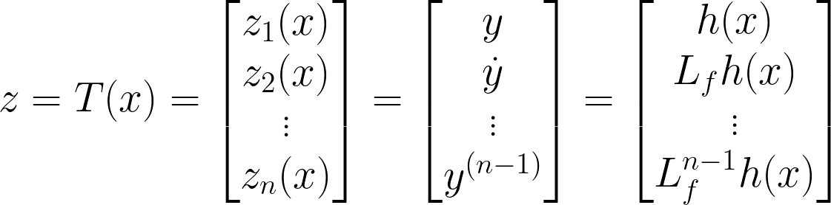
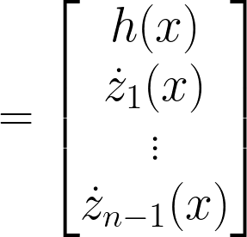
Feedback Linearization – Building the Transform
Knowing that repeatedly differentiating our output with respect to time will eventually cause the control input u to appear gives a fairly natural choice of coordinate system:
Notes:
Now our system looks like this. Our state vector consists of our outputs and its first n-1 time time derivatives – we have expressions for these from the Lie Derivatives we defined earlier and they form an integrator cascade where the z_(i+1)th term is the first time derivative of the z_i th term

Slide 13
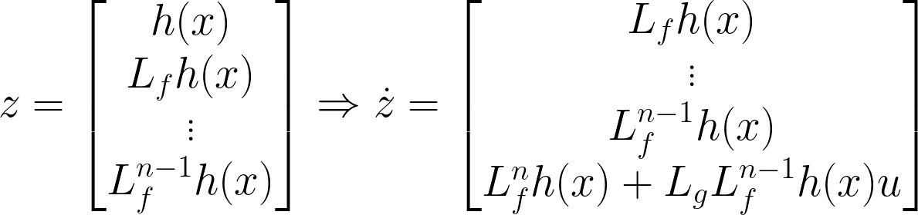
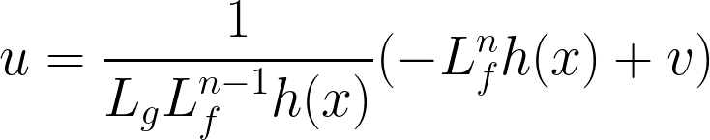
Feedback Linearization – Building the Control Law
Now that we have our Coordinate System, we can build our Control Law to simplify out the Lie Derivatives:
Notes:
From this integrator cascade and our choice of not including the Lie Derivative with the same order as the system degree we find that the time derivative of z ends up depending on u! We can use this to define a convenient control input capable of cancelling out all the lower order Lie Derivatives, leaving only v as our outer loop control input
It’s worth noting that the choice of u is inherent to the method; cancelling the highest order Lie Derivatives cancels out the nonlinear behavior as well. This is why we included v in our control law earlier, to make sure we still had a free parameter to control after this cancellation.
I wrote this assuming LgLf would be a scalar to stay consistent with the presentation in the literature, in practice this will usually be a matrix and will be written as the inverse of LgLf time the rest of the control input

Slide 14
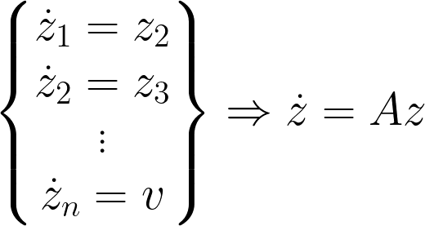
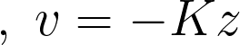
Feedback Linearization – Building the Control Law
With our particular choice of coordinate system and control law, we’ve now built a linear mapping between inputs and outputs:
Notice how the result of all this work is a nicely formatted LTI system!
The LTI system is also posed as an integrator cascade, something which we have many tools to solve!
Proportional State Feedback
Notes:
Let’s step back a bit and look at what we’ve accomplished so far. We’ve redefined our nonlinear system with control input u (which depends on the state and desired control v) to an integrator cascade in a different coordinate system whose control input v is the desired control input from before. The way we’ve solved for our integrator cascade naturally lends itself to being written as a linear system whose exact form we’ll see two slides from now. Further, the steps we’ve taken so far allow us to have a lot of freedom in our choice of control law v. For now, let’s let v be a proportional feedback law dependent on the transformed state z.
Critically, we’ve managed to rephrase our system as an LTI system, which we know how to deal with! Let’s spend the remaining time looking at some of the strengths and weaknesses of this approach.

Slide 15
Feedback Linearization – Properties
The feedback linearized system has a few friendly properties:
It’s linear!
Assuming the transform is a diffeomorphism (a differentiable function whose inverse exists and is also differentiable), any smooth trajectory in the original system corresponds to a unique trajectory in the transformed system
So long as the transform is globally smooth (differentiable) everywhere and the relative system degree is globally constant, this linearization holds globally
Notes:
Let’s first look at the advantages of what we’ve just done:
-First, we successfully linearized the system! But we could’ve done that quicker and easier with other methods, so what did we gain with this?
-One of the biggest gains we’ve made is that we can now develop a set of conditions that will make this linearization hold everywhere; that is to say we’ve actually transformed the system into an equivalent linear one. The conditions of note are that the transform needs be differentiable with a differentiable inverse at all points in the system domain and that the derivative of the transform can’t have any discontinuities in the domain – if both of these hold globally then our linearization does too
-However, even if our transform isn’t smooth we can still be assured that we won’t lose information via this linearization; so long as the the transform and it’s inverse are differentiable unique trajectories prior to transforming will be unique after transforming
-

Slide 16
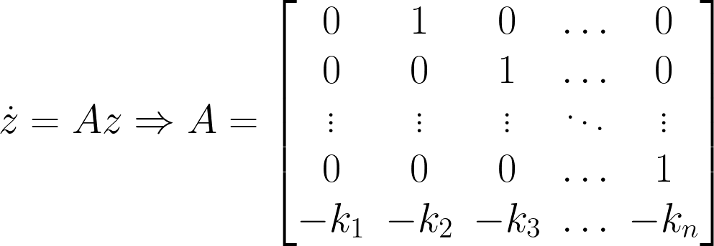
Feedback Linearization – Pole Placement
One final advantage of this method is that we are able to choose where the poles of the linearized system go:
Which is to say proper choice of k allows arbitrary pole placement!
This all follows from our choice of proportional state feedback!
Notes:
The final benefit of this transform, particularly when taken with our choice of v two slides ago, is that we have the ability to individually modify the gain for each term in the state to place closed loop poles anywhere we’d like! This is an incredibly powerful ability that makes applying many of the concepts of linear control design quick, easy and effective.
Finally, I’ll mention some drawbacks of this method – the way in which we’ve built this transform is useful, but also likely to include unstable zero dynamics arising from unobservable states. Additionally, because one of our main underlying assumptions was the smoothness of both the source and target set, discontinuous or otherwise nondifferentiable dynamics are incompatible with this method. Finally and slightly anecdotally, while this approach can (in theory) work with non minimum phase systems, because our requirement is that the inverse merely exist, not that it’s causal and stable, it will preform very poorly if asked to control nonminimum phase dynamics, often causing singularities to appear.

Slide 17
Sources and Slides
Feedback Control of Dynamic Bipedal Robot Locomotion, Westervelt, 2007
Robot Modelling and Control, Spong et al., 2020
A copy of slides and all other resources can be found at:
ter.ps/ABFdbk
Notes:
Thank you for listening!
I’ve listed some of my sources on this slide, with any source which is freely available online (as well as these slides and my speaker notes) being hosted at the provided link.

